Slide 1
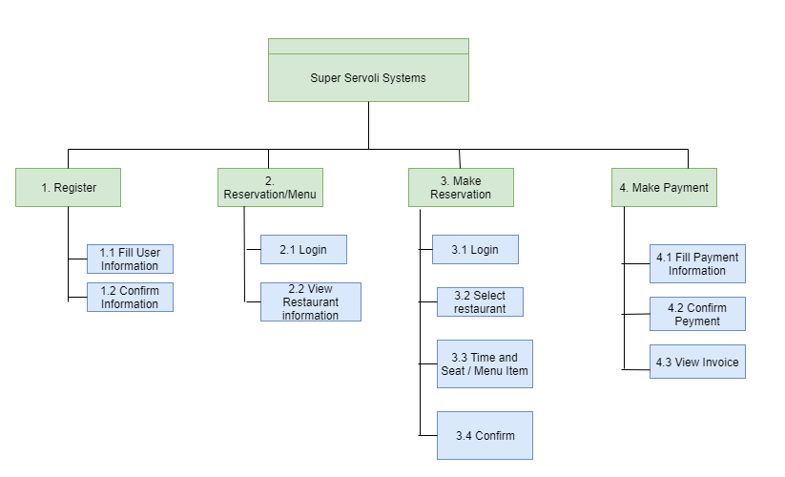
Super Servoli Systems - Functional Decomposition

